Slide 1
The Effects of Urban Population on Temperature Change
Megan Eddy
DSC 530
Final Project

Slide 2
Hypothesis:
Countries with higher urban populations have larger yearly increases in temperature.

Slide 3
Variables
Average Temperature: Average increase of temperature by year in degrees Celsius
Urban Population: Number of people living in urban areas
Rural Population: Number of people living in suburban areas
Total Emissions: Total greenhouse gas emissions (CO2) from various sources
Measured in kilotons (kt) - 1 kt = 1000kg of CO2
Food Retail: Emissions from retail establishments selling food
Measured in kilotons (kt) - 1 kt = 1000kg of CO21990 until 2020

Slide 4
Histograms

Slide 5
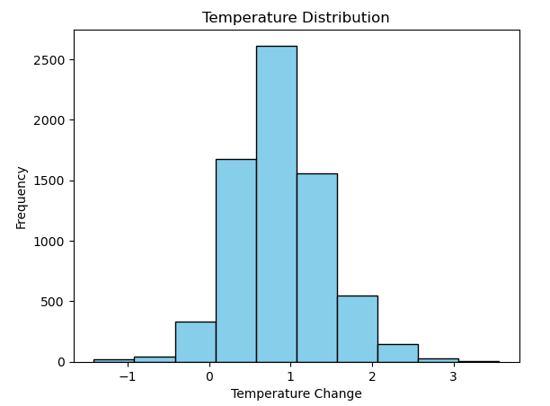
Average Temperature
Bell shaped
No obvious outliers
Minimum Increase: -1.42
Maximum Increase: 3.56
Mean: 0.873
Mode: 0.57, count = 7
Standard Deviation: 0.56
Variance: 0.31
Lower Quartile: 0.51
Upper Quartile: 1.21
Interquartile Range: 0.70

Slide 6
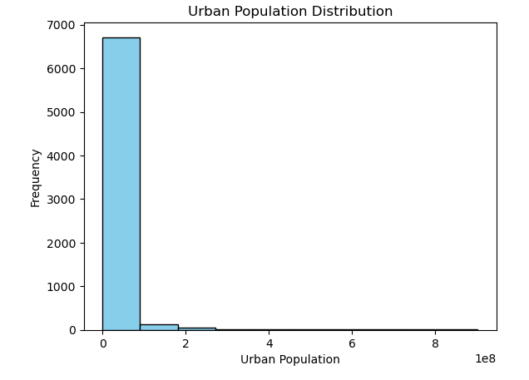
Urban Population
Heavily skewed to the right
Large spread
Outliers will be included
supports hypothesis testing
Minimum Population: 0
Maximum Population: 902077760
Mean: 16932296.97430007
Mode: 0, count = 62
Standard Deviation: 65738899.870
Variance: 7321602956069175.5
Lower Quartile: 217386.0
Upper Quartile: 8277123.0
Interquartile Range: 8059737.0

Slide 7
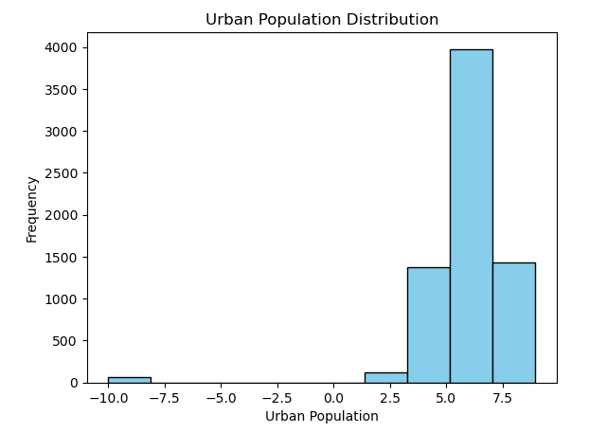
Urban Population - Log
Log taken
Mitigates the effect of large spread
Easier to visualize the range
Left skewed
Minimum: -10.0
Maximum: 8.96
Mean: 6.00
Standard Deviation: 1.91
Variance: 3.67
Lower Quartile: 5.34
Upper Quartile: 6.92
Interquartile Range: 1.58

Slide 8
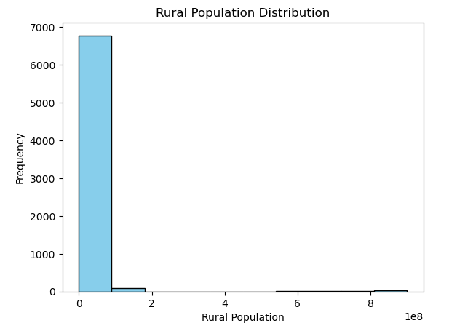
Rural Population
Heavily skewed to the right
Outliers will be included
Supports hypothesis testing
Minimum: 0
Maximum: 900099113
Mean: 17857735.39
Mode: 0, count = 319
Standard Deviation: 89008823.35
Variance: 7922570633524178.0
Lower Quartile: 97311.0
Upper Quartile: 8177340.0
Interquartile Range: 8080029.0

Slide 9
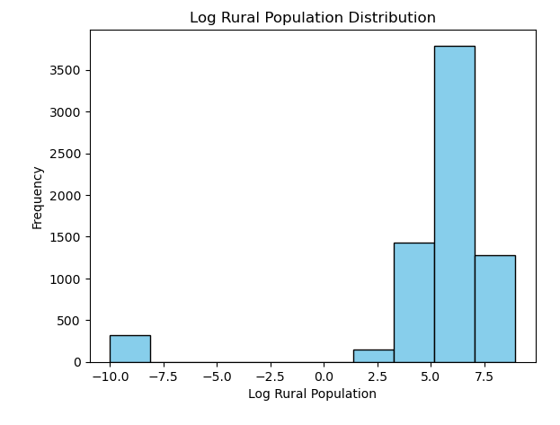
Rural Population - Log
Log taken
Mitigates the effect of large spread
Easier to visualize the range
Left skewed
Minimum: -10.0
Maximum: 8.96
Mean: 5.31
Mode: -10, count = 319
Standard Deviation: 3.56
Variance: 12.67
Lower Quartile: 4.99
Upper Quartile: 6.92
Interquartile Range: 1.92

Slide 10
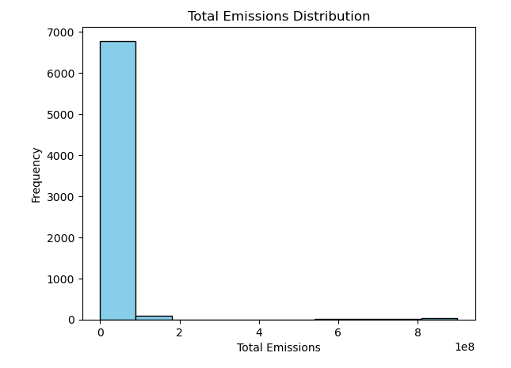
Total Emissions
Heavily skewed to the right
Outliers will be included
Supports hypothesis testing
Minimum: -391884.06
Maximum: 3115113.75
Mean: 64091.244
Mode: 7251.26, count = 22
Standard Deviation: 228296.57
Variance: 52119322663.45
Lower Quartile: 5221.24
Upper Quartile: 35139.73
Interquartile Range: 29918.49

Slide 11
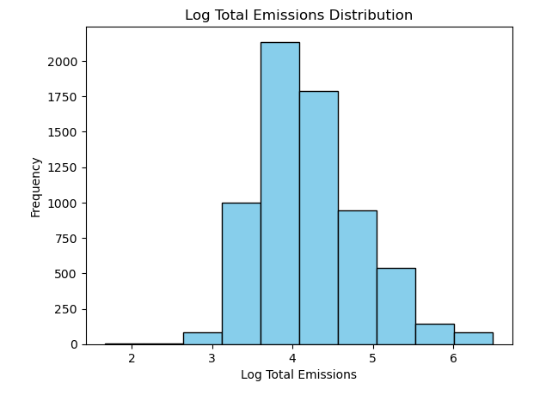
Total Emissions - Log
Log taken
Mitigates the effect of large spread
Easier to visualize the range
Bell shape
Minimum: 1.67
Maximum: 6.50
Mean: 4.21
Standard Deviation: 0.64
Variance: 0.42

Slide 12
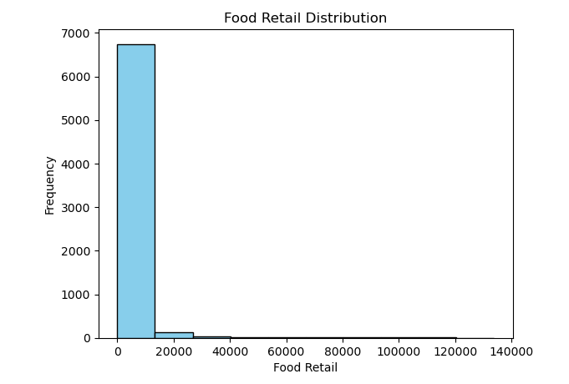
Food Retail
Heavily skewed to the right
Outliers will be included
Supports hypothesis testing
Minimum: 0
Maximum: 133784.07
Mean: 2043.21
Mode: 37.84, count = 119
Standard Deviation: 8493.64
Variance: 72141911.24
Lower Quartile: 26.82
Upper Quartile: 1076.00
Interquartile Range: 1049.18

Slide 13
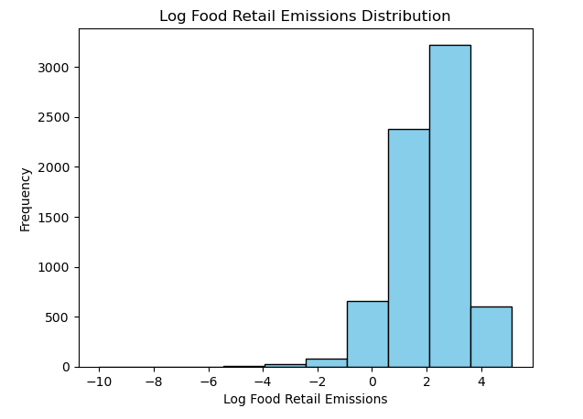
Food Retail- Log
Log taken
Mitigates the effect of large spread
Easier to visualize the range
Left skewed
Minimum: -10.0
Maximum: 5.13
Mean: 2.12
Mode: 1.58, count = 119
Standard Deviation: 1.24
Variance: 1.55
Lower Quartile: 1.43
Upper Quartile: 3.03
Interquartile Range: 1.60

Slide 14
PMF

Slide 15
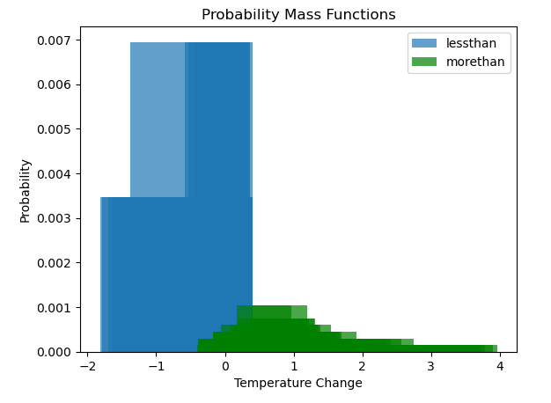
Temperature Change
Less than or equal to zero
Vs
Greater than zero
Decrease more likely than an increase
Low probabilities

Slide 16
CDFs

Slide 17
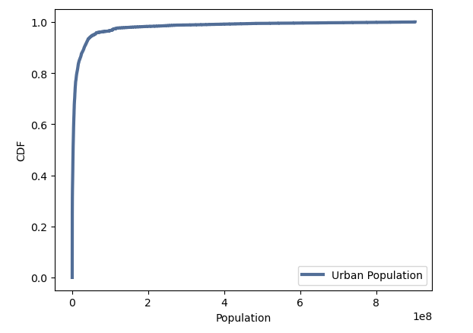
Urban Population
Immediately reaches 1.0
influenced by outliers
influenced by large spread
Better to bin by similar populations
Better to remove lowest populations

Slide 18
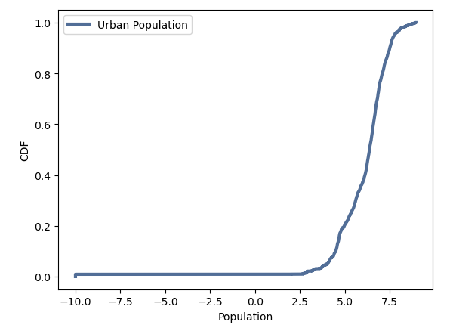
CDF – Urban Population (Log)
~ 20% of the populations are less than log 5.0 (100,000)
Helps determine the distribution of urban populations

Slide 19
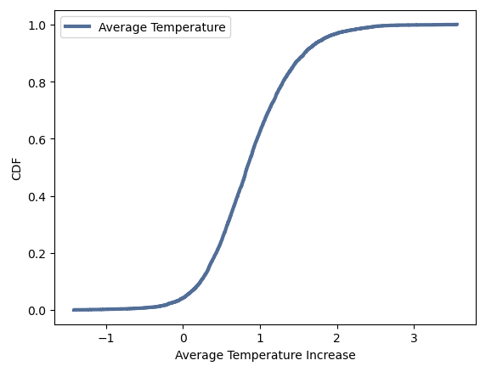
CDF – Average Temperature
~ 10% of ‘increases’ are actually decreases
Helps determine the distribution of temperature changes

Slide 20
Analytical Distribution

Slide 21
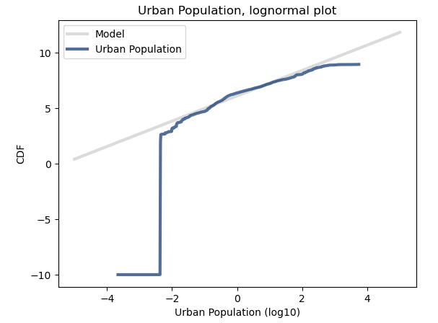
Normal Probability Plot – Urban Population (Log)
Fits in the middle
Lowest range clearly outlier
Deviates in the tails

Slide 22
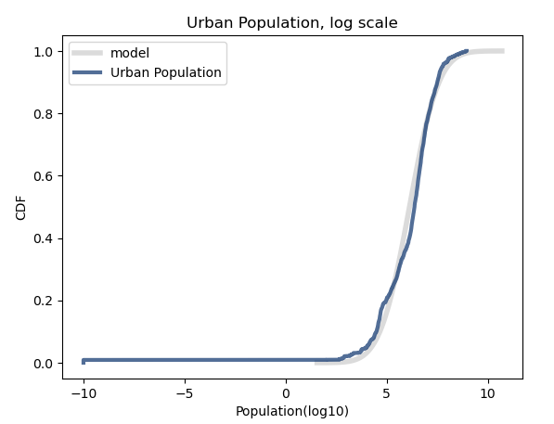
Lognormal Distribution – Urban Population (Log)
Good fit for the model within a few standard deviations

Slide 23
Scatter Plots

Slide 24
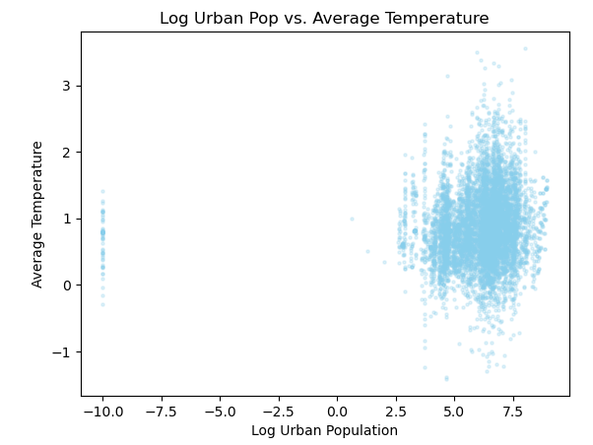
Urban Population (Log) vs. Average Temperature
Covariance: 1325174.48
Log Covariance: 0.11
Correlation: 0.04
Weak positive linear relationship
No evidence of non-linear relationship
Can’t determine causation

Slide 25
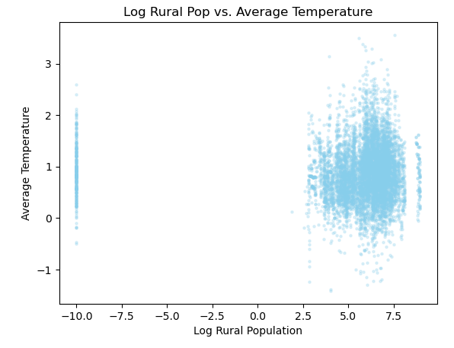
Rural Population (Log) vs. Average Temperature
Covariance: -977902.31
Log Covariance: 0.003
Correlation: 0.04
Weak positive linear relationship
No evidence of non-linear relationship
Can’t determine causation

Slide 26
Hypothesis Test

Slide 27
Correlation
p-value: 0.0
In 1000 trials, the null hypothesis did not produce a correlation larger than the observed correlation
Actual Correlation: 0.101
Max Test Correlation: 0.044
The actual correlation is larger than the largest value seen in the simulation by 0.57
Suggests the null hypothesis can be rejected
Suggests there is a relationship between Urban Population and Average Temperature

Slide 28
Regression Analysis

Slide 29
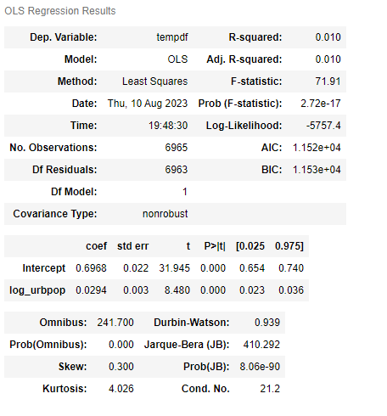
Linear Regression Analysis
Average temperature as dependent
Log of urban population as explanatory
Population explains only very small amount of the variance in the average temperature
Autocorrelation possible
May be high correlation between independent variables
Model is not a strong fit to the data

Slide 30
Conclusion
Not possible to determine causation between the urban populations and average temperature increases from this analysis
Lowest outliers should be removed from the analysis
Other factors are likely influencing the temperature changes

